Slide 1
Grassroots Arts Program Subgranting Workshop
The Arts Council of Wilmington and New Hanover County
May 11 and June 6, 2022

Slide 2
Grassroots Arts Program
The Grassroots Arts program is a partnership between local arts councils and the North Carolina Arts Council. All 100 counties in N.C. receive program funds.
In counties with populations of 50,000 or more, the local arts council will distribute 50 percent of the Grassroots funds to local arts organizations through a competitive grant process.

Slide 3
Eligibility for Application
While nonprofit status is preferred, organizations that have been in operation for a least one year may apply.
All organizations must reside and carry out projects in New Hanover County.
Projects must take place between July 1, 2022 and June 15, 2023.
Only complete applications received by the due date will be considered.

Slide 4
Subgrant Requirements
Matching Requirement
  One – to – one cash match
N.C. Arts Council and Local Arts Council Recognition
  Logos and credit line according to guidelines
Reporting Requirements
  Final Report to the Arts Council of Wilmington and NHC
  Thank you letters to state legislators
  No Overdue Tax Form

Slide 5
What the Grant will Fund
Program expenses for projects of high artistic merit including artist fees and travel, space rental, marketing, advertising, costumes, sets, props, music and equipment rental.
Limited operating expenses for arts organizations only.

Slide 6
What the Grant will Not Fund
Individual applicants
Art supplies
Fundraising events or expenses
Food or beverages
Prizes, tuition or scholarships
School band activities or equipment
Purchase of artwork
Internal programs for schools, colleges, universities, or libraries
Programs with religious content

Slide 7
The Application
Organizational Information & Project Description

Slide 8
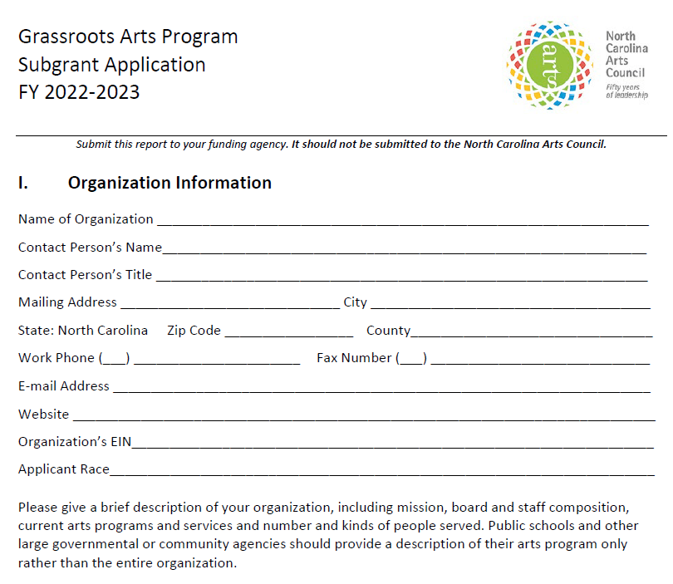

Slide 9
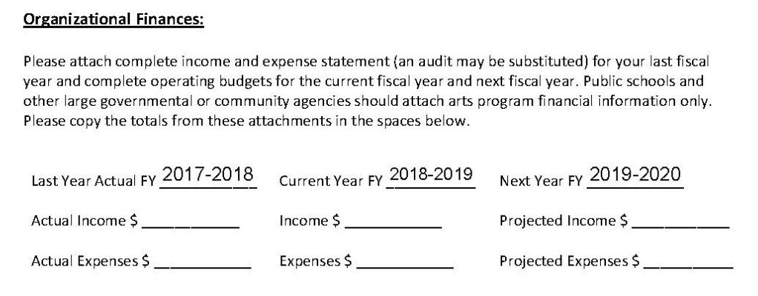
Remember to include a financial statement from your most recent completed FY
2021-2022
2022-2023
2023-2024

Slide 10
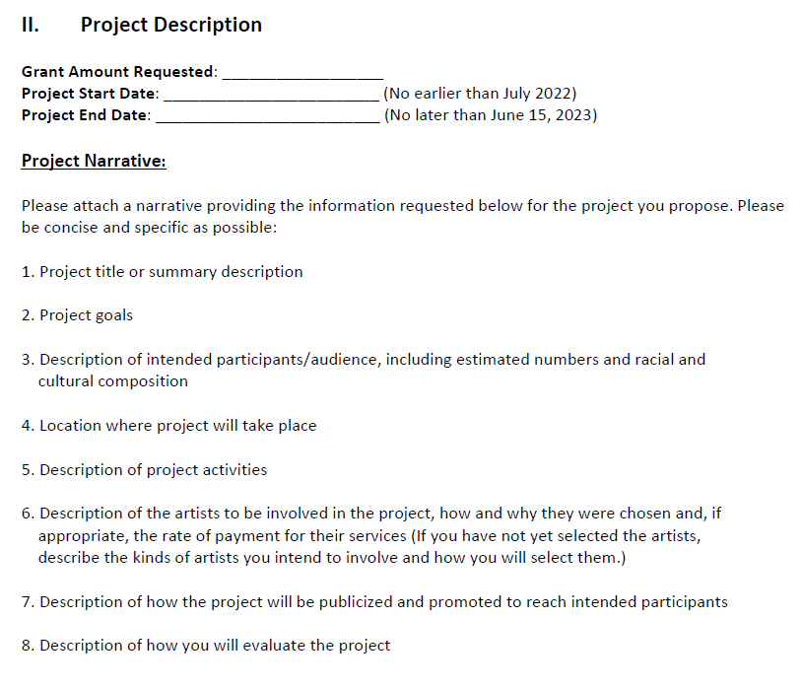

Slide 11
Project Description
Project title or summary description
    Why should the project be funded?
    Include any community partnerships
Project Goals
    What will participants learn or gain from the arts experience?
    How will the project impact the community?

Slide 12
Audience and Location
Description of intended audience or participants:
  Be specific: “We expect the community participation to be 200 adults and 300 middle-school-aged children, with approximately 64% Caucasian and 36% to be African American.”
Location of project

Slide 13
Activities and Artists
Description of Project activities
    For example: Each art camp student will engage in a rotating schedule of visual and performing arts classes. This includes 20 hours a week of instruction, with at least 10 hours devoted to sculpture, drawing and painting and 10 hours to dance, theatre and musical instruction.
Description of the artists involved
    How they were chosen (include credentials in narrative)
    Rate of Payment
    If the artists have not been chosen yet, describe the process for choosing artists.

Slide 14
Marketing and Evaluation
How the project will be publicized and promoted
    Specific outreach to include intended audience?
    Community Partner’s newsletters?
    Press releases, website, advertising, PSAs
How will the project be evaluated?
    Surveys? Participant feedback?
    Revenue?
    Community Impact?

Slide 15
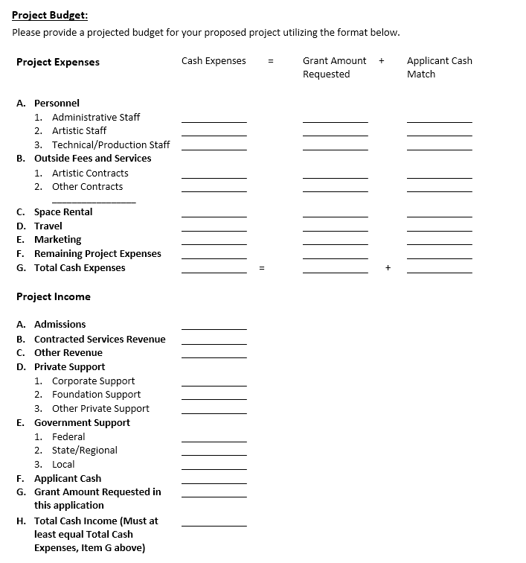

Slide 16
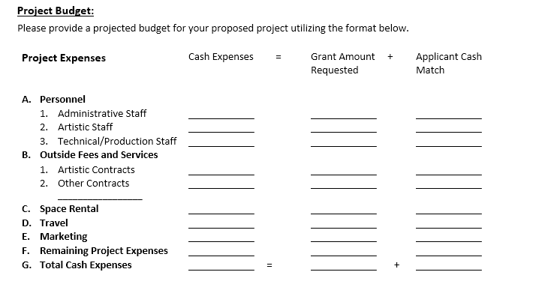

Slide 17
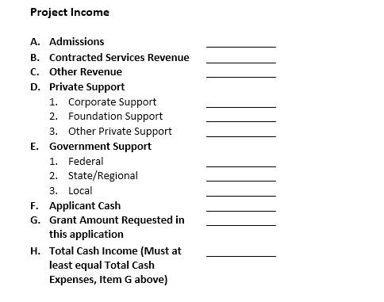

Slide 18
Evaluation
How Applications are Evaluated

Slide 19
Subgrant Panels
Panel of community members review each grant
Panelists must base funding decisions on the quality of the grant application, not on their relationship with, or knowledge of, the organization
Panelists review overall completeness of the grant and score applications on specific criteria

Slide 20
Criteria
Artistic quality of the proposed project
Community impact of project or program
Ability to plan and implement project
Stability and fiscal responsibility of the organization

Slide 21
Priorities for Funding
First Priority: Arts organizations like symphonies, galleries, theaters, art guilds, choral societies, dance companies and music presenters that are not receiving any other funding through the N.C. Arts Council.
Second Priority: Arts learning and arts in education programs conducted by qualified artists.
Third Priority: Civic, municipal or community-based organizations providing quality art experiences for the greater community.

Slide 22
If you get funded…
Your organization will enter into a contractual agreement with the Arts Council of Wilmington & NHC
Submittal of No Overdue Tax Debts Form
Your organization will complete a final report by June 30 with:
    Audience numbers
    Audience demographics
Demonstrate use of N.C. Arts Council logo and credit line on promotional materials
Grant payments may be distributed in installments
Keep local arts council updated on the progress of your program. If something changes and you can’t use all the funds, your local arts council must know by April. They will need to roll the funds into one of their programs.
NOTE: Late final reports=no funding next grant cycle.

Slide 23
Questions?
If you need help with your application, or have specific questions, contact:
Rhonda Bellamy
President & CEO
(910) 343-0998
grants@artswilmington.org

